Slide 1
Algo Allies
Project report

Slide 2
STANDARD TEMPLATE LIBRARY
Templates in C++: Templates allow you to write generic code that can be reused with different data types. They are expanded at compile time, which means that the compiler generates code specific to the data types used with the template.
STL in C++: it is a collection of template classes which provide common data structures, a range of containers such as lists, vectors. It also provides functions and optimized algorithms like sorting, searching etc. which can result in faster execution times compared to custom code.
Key components of STL:
Algorithm
Containers
Functors
Itorators

Slide 3
ALGORITHMS
Algorithms refer to a set of generic functions that operate on containers and manipulate their elements. They include common operations of modifying, and analyzing data within containers.
Header file: #include <algorithm>
Some of the algorithms in STL are:
sort(first_iterator, last_iterator) – To sort the given vector. It sorts the given vector in ascending order.
reverse(first_iterator, last_iterator) – To reverse a vector. ( if ascending -> descending OR if descending -> ascending)
accumulate(first_iterator, last_iterator, initial value of sum) –Does the summation of vector elements
binary_search(first_iterator,last_iterator,x) – Tests whether x exists in sorted vector or not.

Slide 4
CONTAINERS
These are classes or data structures that are used to store and organize collections of objects or elements. Containers provide a way to manage and manipulate groups of data in a structured manner.
Some examples are:
Vectors
Arrays
Queues
Map
Set
Stack

Slide 5
VECTOR
Vector is a container class that represents a dynamic array. It allows you to store and manipulate a collection of elements of the same data type. Unlike a fixed-size array, a vector can dynamically resize itself to accommodate a varying number of elements. It provides a convenient interface and several member functions to efficiently manage and access its elements.
Header file: #include <vector>
It has various member functions such as:
size() – Returns the number of elements in the vector.
at(g) – Returns a reference to the element at position ‘g’ in the vector
front() – Returns a reference to the first element in the vector
back() – Returns a reference to the last element in the vector
push_back() – It push the elements into a vector from the back
pop_back() – It is used to pop or remove elements from a vector from the back.

Slide 6
QUEUE
Queue is a container class that represents a First-In-First-Out (FIFO) data structure. It is used to store a collection of elements in a specific order where the element that is added first is the first one to be removed.
Header file: #include <queue>
Std: :queue<int> Q;
Q.push(10);
Q.push(20);
Q.pop() and Q.front() return the value 10 (first in).

Slide 7
STACK
Stack is a container class that represents a Last-In-First-Out (LIFO) data structure. It is used to store a collection of elements in a specific order where the element that is added last is the first one to be removed.
Header file: #include <stack>
Std: :stack<int> S;
S.push(10);
S.push(20);
S.top() and S.back() return the value 20 (last in).

Slide 8
SET
Set is a container class that represents a collection of unique elements in a specific order. It is used to store and manage a sorted set of elements with no duplicates.The values are stored in a specific sorted order i.e. either ascending or descending.
Header file: #include <set>
Std: :set<int> S;
S.insert(10);
S.insert(20);
S.erase(20); // erases 20 from the set

Slide 9
FUNCTORS
Functors are objects that can be treated and used as if they were functions.A functor is any object that can be invoked using the function call operator ().
#include <iostream>
class Incrementer {
public:
int operator()(int value) const {
return value + 1;
}
};
int main() {
Incrementer increment;
int result = increment(5); // Using the functor like a function
std::cout << result << std::endl; // Output: 6
return 0;
}
Incrementer class defines the function operator ,operator(), which increments the input value by 1. An instance of the Incrementer class is created, and the instance is used as a functor by calling it with an argument.

Slide 10
What is Time Complexity ?
The Time Complexity of an algorithm is an estimate of the amount of time it takes to execute for a given input size. This amount of time depends on the number of steps needed to be performed by the computer to run the algorithm for that input.
Hence Time Complexity is the number of steps required to compute the output for the worst case scenario. Time Complexity of an algorithm/program is usually represented in the Big O Notation.
In coding competitions on Codeforces the number of steps should not exceed 10^8 (10^7 to be on the safe side) as the time limit for the questions is usually 1 second.

Slide 11
Big O Notation
The Big O Notation is used to represent the Time Complexity of an algorithm.
The time complexity of an algorithm which takes a constant number of steps to execute is denoted by O(1).For an algorithm in which number of steps required is proportional to the size of input the time complexity is denoted by O(n).
Similarly if number of steps is proportional to square of size of input the time complexity is denoted by O(n*n).

Slide 12
Note!!!
While writing the Big O Notation we ignore all constants.
For example the Big O Notation for the time complexity of a program which takes 3*N+6 steps to execute is O(N) .
Also if a program consists of codes which have different time complexities then the time complexity of the program will be the largest of these time complexities.
For example if the program consists of codes with Time Complexities O(1),O(n),O(n*n) then the time complexity of the program will be O(n*n).
If a program has multiple inputs then each of these inputs come in time complexity equation depending on how the number of steps depends on these inputs.

Slide 13
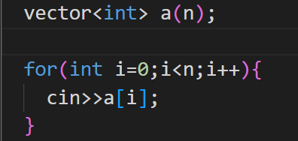
Example-1
The time complexity of the following code is:
O(n) as the total number of steps performed=(number of steps in each iteration*number of iterations)=1*n

Slide 14
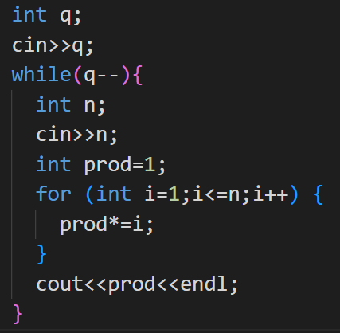
Example-2
The time complexity of the following code is:
O(N*q) where N is the largest possible value of n (considering the worst case scenario).
This is because the inner loop runs for at max N times for each iteration of outer loop.

Slide 15
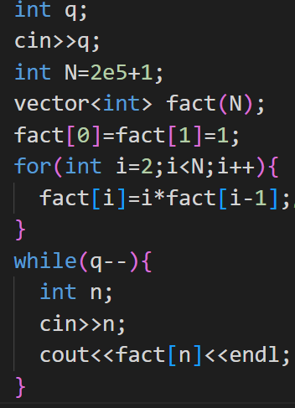
Example-3 (Alternative of Code given in Example-2)
The time complexity of the following code is:
O(N+q) where N is the largest possible value of n (considering the worst case scenario).
This is because the it takes N steps to construct the vector and the second loops runs for q*3 number of steps.

Slide 16
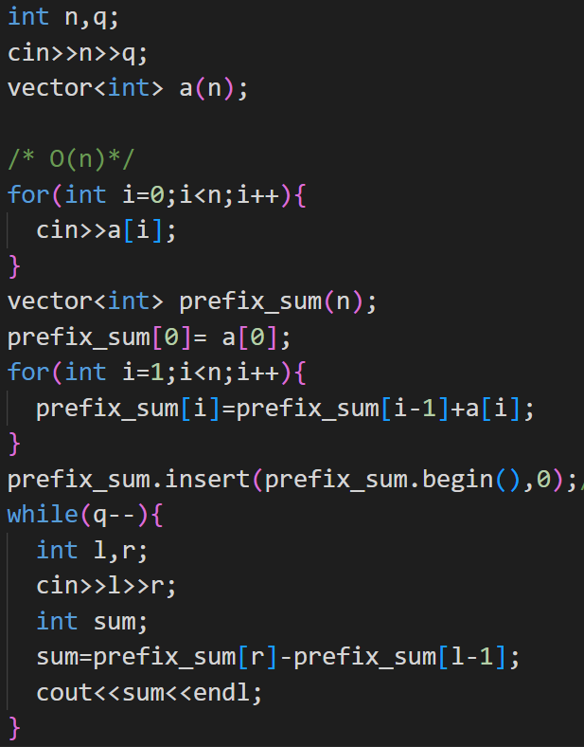
Example-4
The time complexity of the following code is:
O(n+q) as it takes (ignoring some constants) 2*n steps to create and fill the vector. Also the while loop performs 5*q steps. Ignoring the constants we get the time complexity.

Slide 17
Number Theory
Topics covered :
Sieve of Eratosthenes
Prime Factorization
Modular Arithmetic
Modular inverse
Why do we need Modular Arithmetic?
Fermat’s Theorem
Binary Exponentiation

Slide 18
Sieve of Eratosthenes
It is a pre computational algorithm to build an array of length n, through which we can easily check whether a number k (2≤k≤n) is prime or not. The algorithm builds an array sieve whose positions 2,3,...,n are used. The value sieve[k] = 0 means that k is prime, and the value sieve[k] ≠ 0 means that k is not a prime and one of its prime factors is sieve[k].
The algorithm iterates through the numbers 2...n one by one. Always when a new prime x is found, the algorithm records that the multiples of x (2x,3x,4x,...) are not primes, because the number x divides them.

Slide 19
Prime factorization
Modulo Arithmetic
Every number N can be written as a product of its prime factors as
N = (p1^a1).(p2^a2).....(pk^ak)
We can write an algorithm to write prime factorisation of any number.
If a number a when divided by m gives a remainder r, then in modulo arithmetic we write it as: a = r (mod m)
It can be easily be proved that if a = p (mod m) and b = q (mod m),
then a*b = p*q (mod m). This property is used to simplify remainder calculations.

Slide 20
Modular inverse
Why do we need Modular arithmetic?
If x*y = 1 (mod m), then x and y are called modular inverse of each other. For example, if x = 6 and m = 17, then y = 3, because 6*3 mod 17 = 1. Using modular inverses, we can divide numbers modulo m, because division by x corresponds to multiplication by x⁻¹.
For eg. 210/6 mod 17 = (210 mod 17) * (6⁻¹ mod 17) = 6*3 mod 17 = 1.
This can be used to write function for evaluating ^{n}C_{r} mod m.
int data type can only store integers in the range -2^31 to 2^31 -1. 2^31 is approx 2e9. Even if use long long int data type we can only use numbers upto the order of 10e18. For such large numbers answer is reported generally as a remainder of some large divisor (like 1e9 +7). So if answer is N, and N = x (mod M), we report x as our ans.

Slide 21
Fermat’s Theorem
Fermat’s theorem states that if p is a prime number, then for any number a such that a and p are coprime, a^{p-1} mod p =1.
This theorem can be used to calculate x⁻¹.
x^{p-1} = x * x^{p-2}
and since x^{p-1} mod p =1, x * x^{p-2} mod p =1
Hence x⁻¹ = x^{p-2}.

Slide 22
Binary exponentiation
Binary exponentiation (also known as exponentiation by squaring) is a trick which allows us to calculate a^{n} in an efficient manner. (Time Complexity: O(logn))
Let us understand this by an example. To calculate 3¹³, we can write 13 as 8+4+1, i.e. in powers of two (binary representation). Then 3¹³ = 3⁸ *3⁴ *3¹. So to calculate 3¹³ we have to only compute powers of 3 upto 3⁸, and then do 3 multiplications. Naive solution to this would have been to multiply 3 eighteen times, which would take O(n) time.
This method can be used to evaluate modulo of large exponents efficiently.

Slide 23
Contests:-
Contest 1:- Contest today(21/5/23)-1pm to midnight 11:59 pm https://codeforces.com/contestInvitation/2546dfdada8bd9448bf837da2cbaa0d133049803
Contest 2:- https://codeforces.com/contestInvitation/be3a7e110d97d27bebc6a28b5cd05b7832d9c894
Contest 3:- https://codeforces.com/contestInvitation/4a43f065ec1d645d1e60ab855b12b7fe1a47c55b

Slide 24
Solutions to contests:-
Contest-1 solution
https://drive.google.com/drive/folders/1qo05kgUnikQ1jBeSgVGkR__80wanNb7H?usp=sharing
Contest 3 solution :-
Que 1:
https://discord.com/channels/1104019359577428050/1120791963059363920/1121059672263245914
Que 2:
https://discord.com/channels/1104019359577428050/1120792034970714245/1121059692962128026
Que 3:
https://discord.com/channels/1104019359577428050/1120792034970714245/1121059692962128026

Slide 25
Que 3: https://discord.com/channels/1104019359577428050/1120792097285480528/1121059713262551091
Que 4: https://discord.com/channels/1104019359577428050/1120792134874828820/1121059743012749392
Que6:
https://discord.com/channels/1104019359577428050/1120792205762760744/1121059760268132352
Que7:
https://discord.com/channels/1104019359577428050/1120792252520861696/1121059787313000529

Slide 26
Solutions to contests:-

